Slide 1

Encrypted SMS from ESMS
Jacob Holz
Nam Huynh
Gilbert Lavin
Landon Moon
Parker Steach

Slide 2
What & WHY?
Problem
Most communication applications use company owned relay servers
• Problem
Most communication applications use company owned relay servers.
• So...?
A company owned relay server may have the information required to break encryption on an E2E Encrypted message or even legal requirements to be able to do so.
• SMS
Encrypted SMS is intended as a tool that will use SMS, a very insecure protocol, as the transport layer. Encryption allows this to be secure and SMS removes the need for private relays associated with us.
• What about... ?
Other applications also promise E2E Encryption, some even over peer-to-peer connections, but all require some relays. They also hide the transport layer, while all the data being sent and received will be easily visible to the user in our application.
A company owned relay server may have the information required to break encryption on an E2E Encrypted message or even legal requirements to be able to do so.
So?
Encrypted SMS is intended as a tool that will use SMS, a very insecure protocol, as the transport layer. Encryption allows this to be secure and SMS removes the need for private relays associated with us
SMS
What about…?
Other applications also promise E2E Encryption, some even over peer-to-peer connections, but all require some relays. They also hide the transport layer, while all the data being sent and received will be easily visible to the user in our application.
2

Slide 3
Key Requirements
1
4
ESMS must have the capacity to encrypt text messages to varying security levels based on user selection.
ESMS must extract the phone’s contact information, providing a seamless experience for the user.
2
5
ESMS should offer a user-friendly interface, allowing easy navigation between conversations.
ESMS must utilize the phone’s messaging history, to allow users to access past conversations.
3
6
ESMS should educate users on communication security concepts and clearly communicate the security of a given conversation.
SMS must allow users to customize application settings, including encryption methods, on both a global and per-conversation basis.

Slide 4
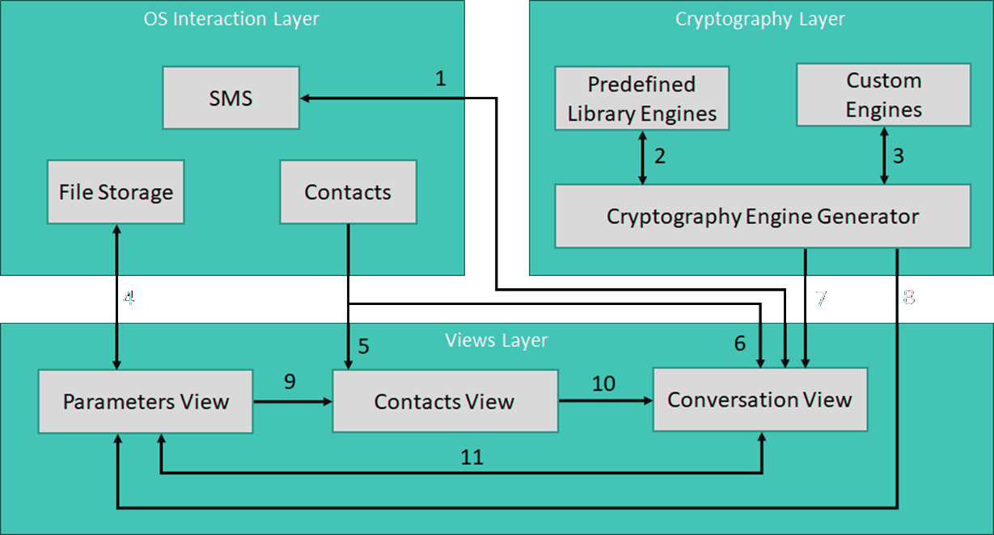
ADS Walkthrough

Slide 5
UI Prototype overview
• Goal
ESMS’s UI goal is to emulate the classic SMS messager feel with additions related to the encryption of SMS messages.
• Prototype so far
Very basic retrieval and display of relevant data from the phone. This includes contacts and message history. Navigation between these two primary screens are also implemented
• UI Next Steps
There are some unfinished details with the current UI prototype such as information transfer between screens. This will be implemented by making a ViewModel. This is part of the MVVM architectural style.
Sending messages has not been implemented yet. A SMSManager class is used to interface with the phone to send any SMS related message
UI prototypeing for secondary screens (shown in blue on next screen). These can be modals and/or drawers.

Slide 6
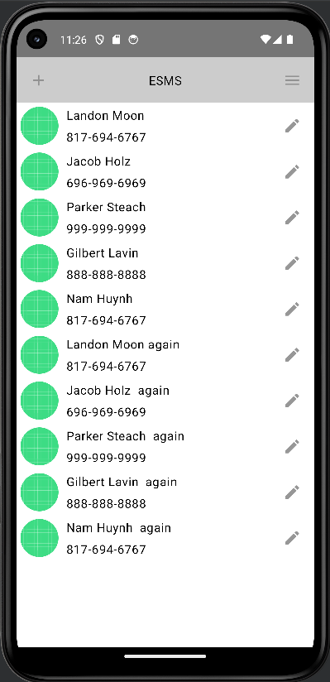
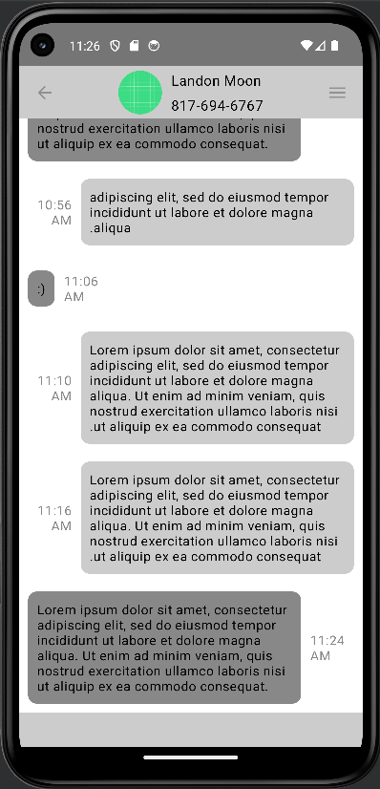
UI Prototyping
Click Back to Contacts Screen
Create Contact
Global Settings
Conversation Settings
Click Contact to Navigate to Conversation Screen
Edit Contact
Message Input

Slide 7
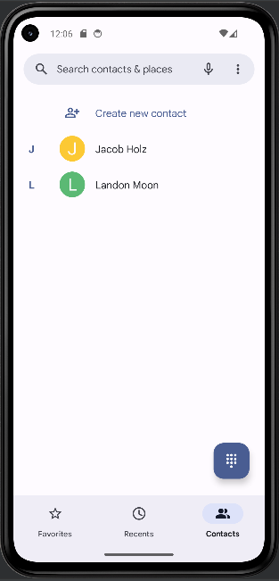
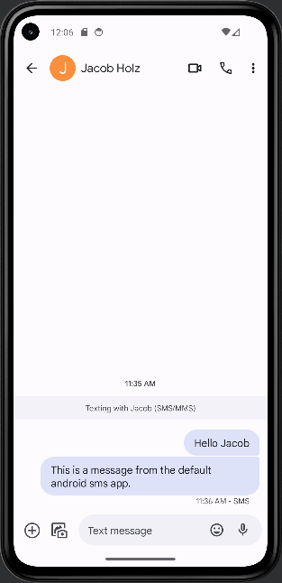
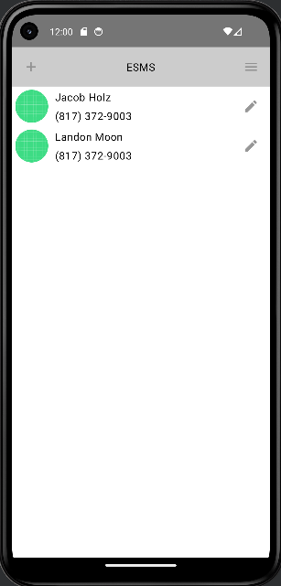
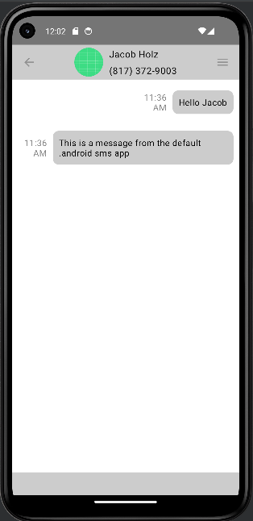
UI data retrieval
Default SMS
ESMS

Slide 8
Next Steps
1
2
Setting up core features: SMS sending, encryption engine, and more UI updates
Over the break, we will plan to implement alternative encryption methods using our engine and refine our SMS sending and how it is displayed

Slide 9

????????Questions?????????????????????????????????????????????????????????????????????????????????????Questions?????????????????????????????????????????????????????????????????Questions???????QUESTIONS???????????????????????????????????????????????????????????????????????????????????????????
????????Questions?????????????????????????????????????????????????????????????????????????????????????Questions?????????????????????????????????????????????????????????????????Questions???????QUESTIONS???????????????????????????????????????????????????????????????????????????????????????????
????????Questions?????????????????????????????????????????????????????????????????????????????????????Questions?????????????????????????????????????????????????????????????????Questions???????QUESTIONS???????????????????????????????????????????????????????????????????????????????????????????
????????Questions?????????????????????????????????????????????????????????????????????????????????????Questions?????????????????????????????????????????????????????????????????Questions???????QUESTIONS???????????????????????????????????????????????????????????????????????????????????????????

